Slide 1
Unit 5: Machine Learning
Lecture 2

Slide 2
Probability in AI
Probability provides a way of summarizing the uncertainty in knowledge and probability statements indicate the evidence with respect to which the probability is being associated.
Usually probability is the description of the likelihood of an occurance of event in the range 0-1.
In AI following probability experiments are considered.

Slide 3
Independent Events:
Two events E1 and E2 are independent if the occurance of E1 doesn’t affect the occurance of E2.
Eg. Probability of toothache and probability of rise in petrol price.
Mutually Exclusive Events:
Events E1,E2,E3 …..En are mutually exclusive if the occurrence of any one of them automatically implies non occurrence of the remaining n-1 events

Slide 4
Eg. More the economic crisis less will be the purchasing behavior of the consumers.
Unconditional Probability:
An unconditional probability is the chance that a single outcome results among several possible outcomes. The term refers to the likelihood that an event will take place irrespective of whether any other events have taken place or any other conditions are present.

Slide 5
Conditional Probability:
In probability theory, conditional probability is a measure of the probability of an event occurring, given that another event has already occurred.
The formula for conditional probability is derived from the probability multiplication rule, P(A and B) = P(A)*P(B|A)

Slide 6
Bayes Theorem
Bayes' theorem, named after 18th-century British mathematician Thomas Bayes, is a mathematical formula determining conditional probability.
Conditional probability is the likelihood of an outcome occurring, based on a previous outcome occurring.
Bayes' theorem provides a way to revise existing predictions or theories (update probabilities) given new or additional evidence.

Slide 7
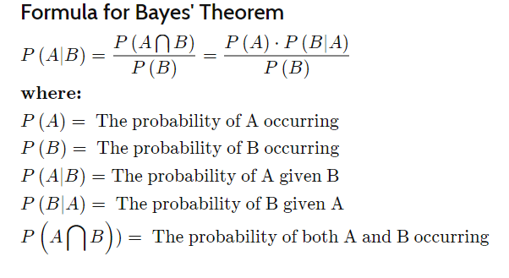

Slide 8
Advantages of Naïve Bayes Classifier:
Naïve Bayes is one of the fast and easy ML algorithms to predict a class of datasets.
It can be used for Binary as well as Multi-class Classifications.
It performs well in Multi-class predictions as compared to the other Algorithms.
It is the most popular choice for text classification problems.

Slide 9
Disadvantages of Naïve Bayes Classifier:
Naive Bayes assumes that all features are independent or unrelated, so it cannot learn the relationship between features.

Slide 10
2. Support Vector Machine Algorithm
Support Vector Machine or SVM is one of the most popular Supervised Learning algorithms, which is used for Classification as well as Regression problems. However, primarily, it is used for Classification problems in Machine Learning.
The goal of the SVM algorithm is to create the best line or decision boundary that can segregate n-dimensional space into classes so that we can easily put the new data point in the correct category in the future. This best decision boundary is called a hyperplane.

Slide 11


Slide 12
Example:
SVM can be understood with the example that we have used in the KNN classifier.
Suppose we see a strange cat that also has some features of dogs, so if we want a model that can accurately identify whether it is a cat or dog, so such a model can be created by using the SVM algorithm.
We will first train our model with lots of images of cats and dogs so that it can learn about different features of cats and dogs, and then we test it with this strange creature.

Slide 13
So as support vector creates a decision boundary between these two data (cat and dog) and choose extreme cases (support vectors), it will see the extreme case of cat and dog.
On the basis of the support vectors, it will classify it as a cat. Consider the below diagram:

Slide 14
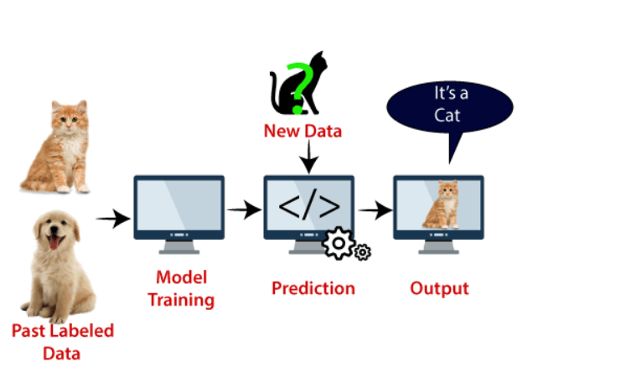
VM algorithm can be used for Face detection, image classification, text categorization, etc.

